Slide 1
AUDIT MANAGEMENT SYSTEM
POD MEMBERS:
Ganesh(POD Leader)-851354
Alisha-851344
Meghana-851345
Jayasree-851342

Slide 2
OUR RESPONSIBILITIES
Ganesh - Authentication Microservice, Client
Alisha - Audit Checklist Microservice, UI
Jayasree - Audit Benchmark Microservice
Meghana - Audit Severity Microservice

Slide 3
ACKNOWLEDGEMENT
We did the project(Audit Management System) for our MFPE under the continuous guidance of
Mentor-Vikram
Trainer- Shrivalli Maheshwaran
We would like to thank them for continuous support
With Regards
Ganesh(851354)
Alisha(851344)
Meghana(851345)
Jayasree(851342)

Slide 4
HARDWARE AND SOFTWARE REQUIREMENTS
Hardware Requirements:
Developer Laptop with 8GB RAM
Software Requirements:
Visual Studio 2019 Community Edition
SQL Server 2014
Postman Client in Chrome
Azure Cloud Access

Slide 5
PROJECT OVERVIEW
Audits are an important and essential part of managing risk and control effectiveness within an organization.
Audit Management is an important tool for the continuous evaluation of the methods and performance of an enterprise. The prime objective of Audit Management is to locate defects of irregularities in the areas covered by the audit and to suggest remedial action.
Steps and Actions
The portal invoke the Authentication Microservice to get the JWT.
The answers to the audit checklist questions along with the basic project information will be filled in the Audit Request object. This will be sent as input to the Audit Severity Microservice.
Audit Severity microservice should interact with Audit Benchmark service.
The response from Audit Severity Microservice along with the basic project information will be stored in the database through the Web application.

Slide 6
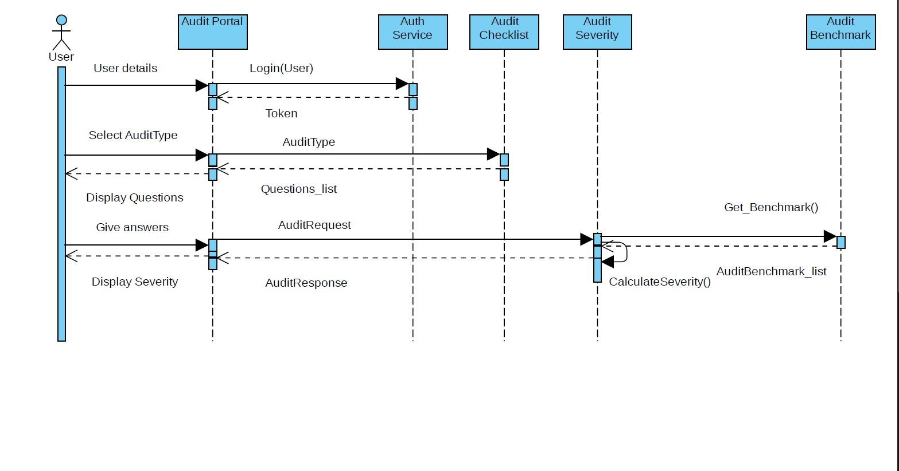
WORK FLOW

Slide 7
MODULES
Authentication Module:
Authentication module is a Microservice that performs the operations like login and logout in our Audit Management portal with all the correct credentials
Security Requirements
Create JWT
Have the token expired after specific amount of time say 30 minutes
Audit Checklist Microservice
The intent of this Microservice is to provide the list of questions for Audit checklist ,the questions will be used to display the questions on the Web UI

Slide 8
MODULES
Audit Benchmark Microservice
This Microservice should provide the acceptable benchmark value for every audit type. It should return a list of values with Audit Type and Acceptable benchmark value of number of questions whose answers can be NO
Audit Severity Microservice
Audit Severity Microservice should be invoked from Audit management portal. Post authorization of request, it allows the following operations:
Based on the Audit request input, the Audit Benchmark Microservice should be invoked to analyze the count of questions whose answer can be NO
Determine the project execution status and arrive at the remediation duration detail

Slide 9
MODULES
Audit Management Portal
Audit management portal must allow a member to Login. Once successfully logged in, the member do the following operations:
Choose the audit type to view the list of audit checklist questions
Let the project manager provide answers to the questions
Invoke the Audit Severity Microservice to determine the project execution status
Display the result on the Web UI
The audit request detail along with the project execution status and remedial action duration should be saved to the database

Slide 10
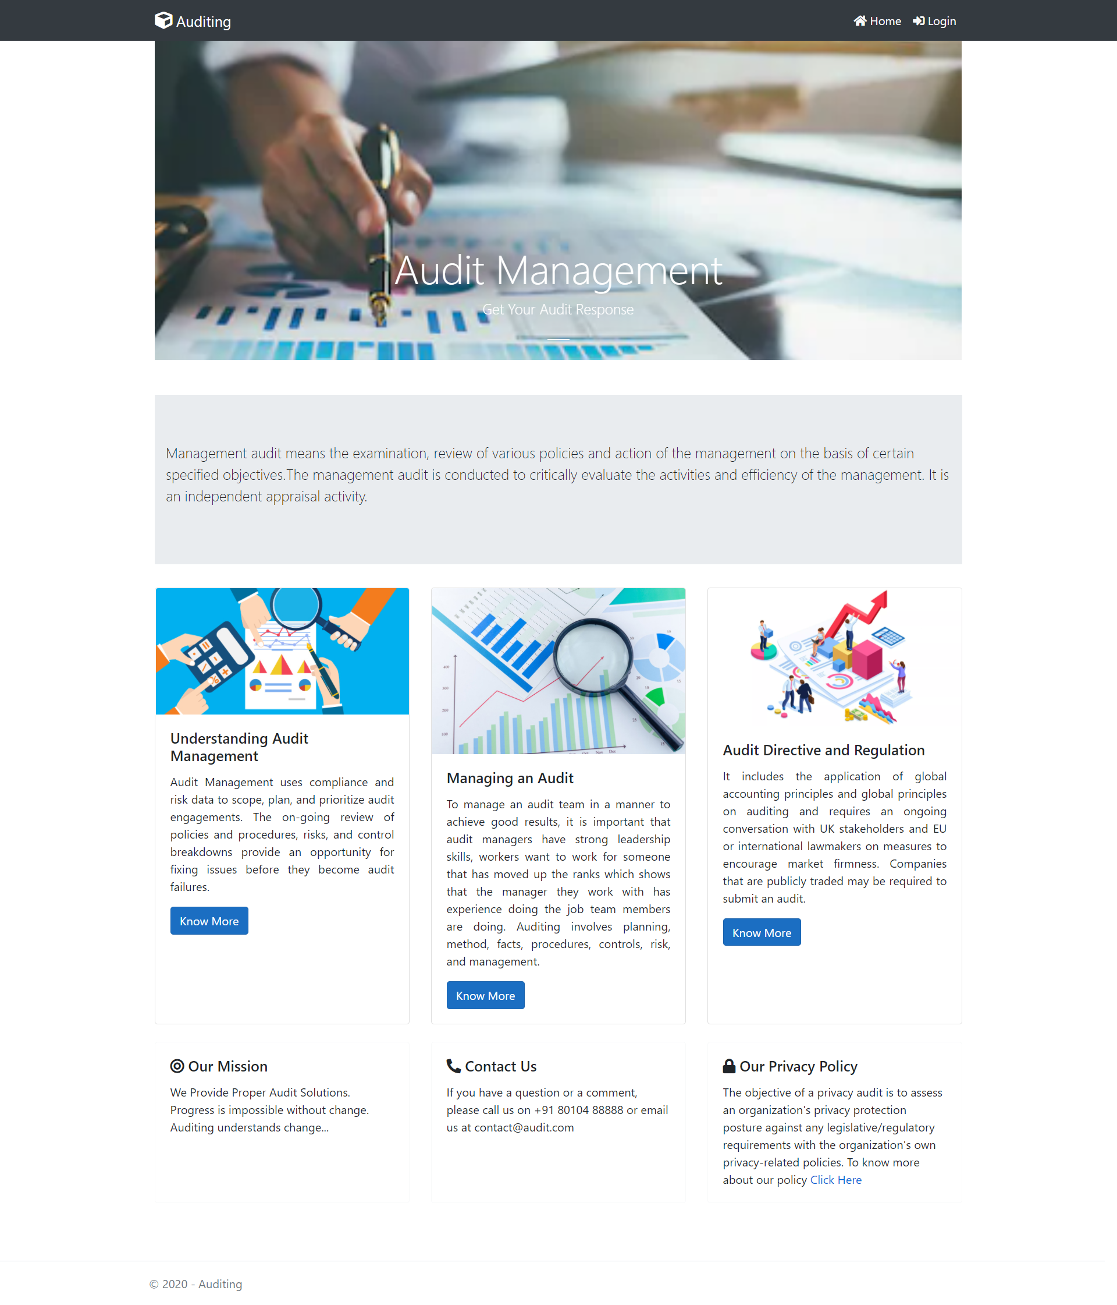
PROJECT FLOW

Slide 11
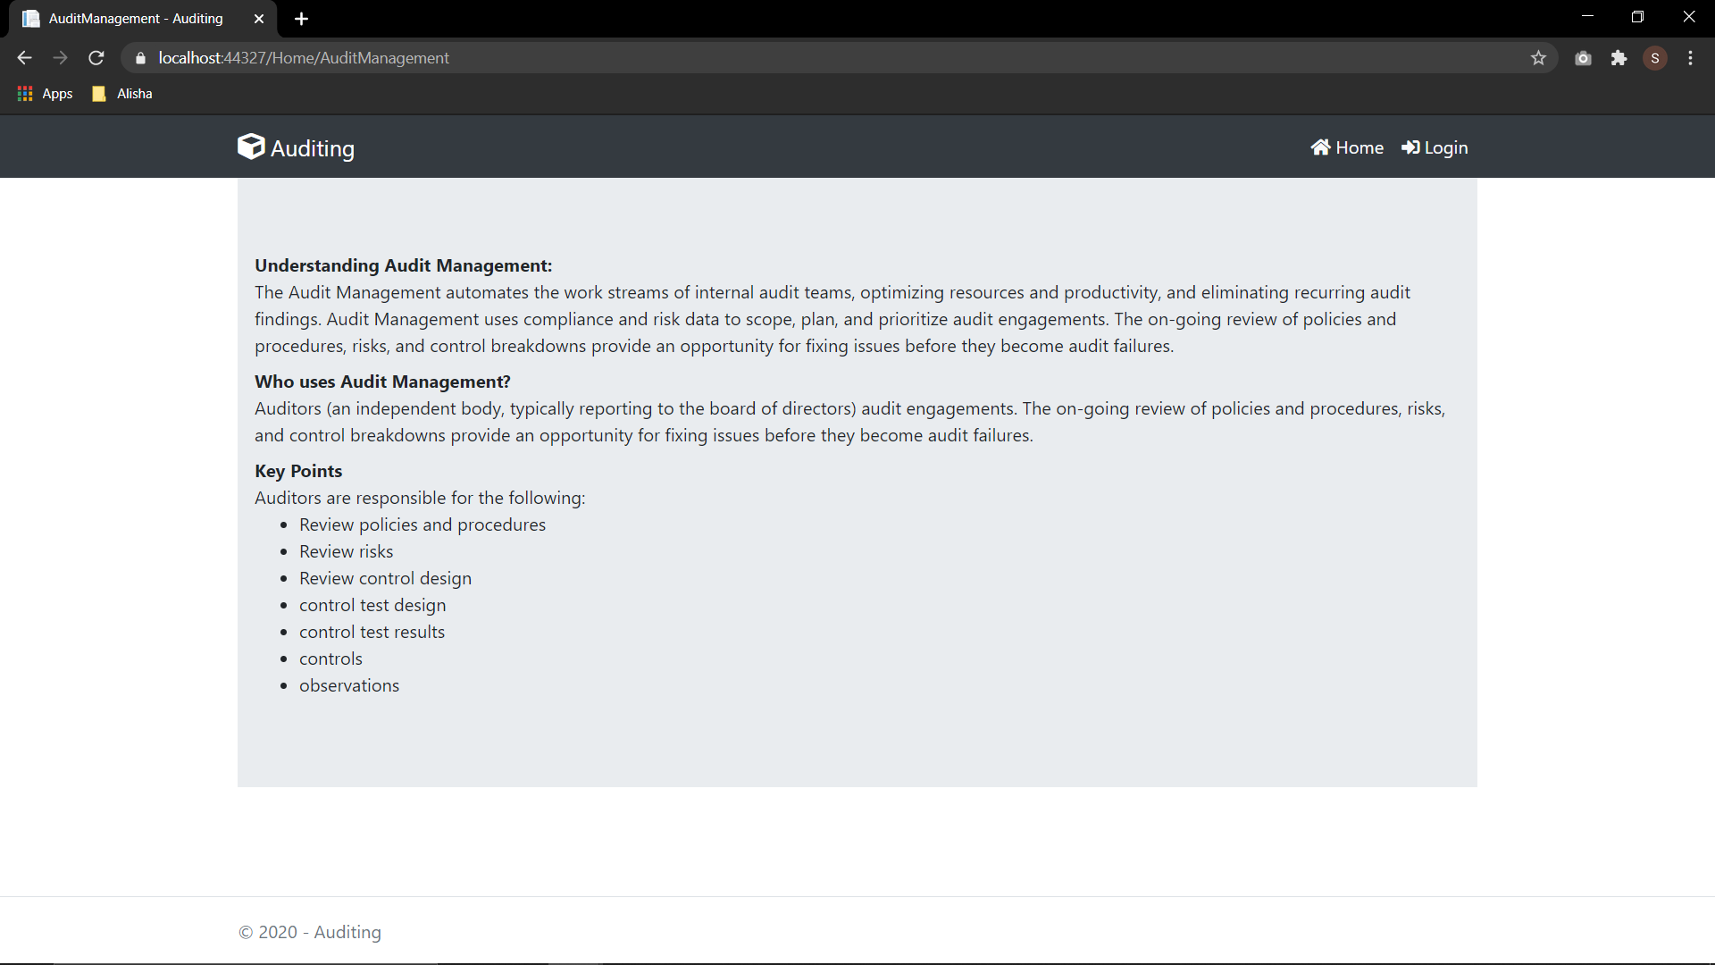
PROJECT FLOW

Slide 12
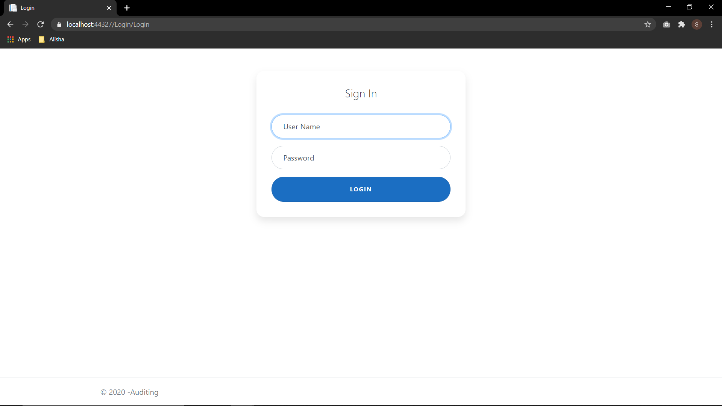
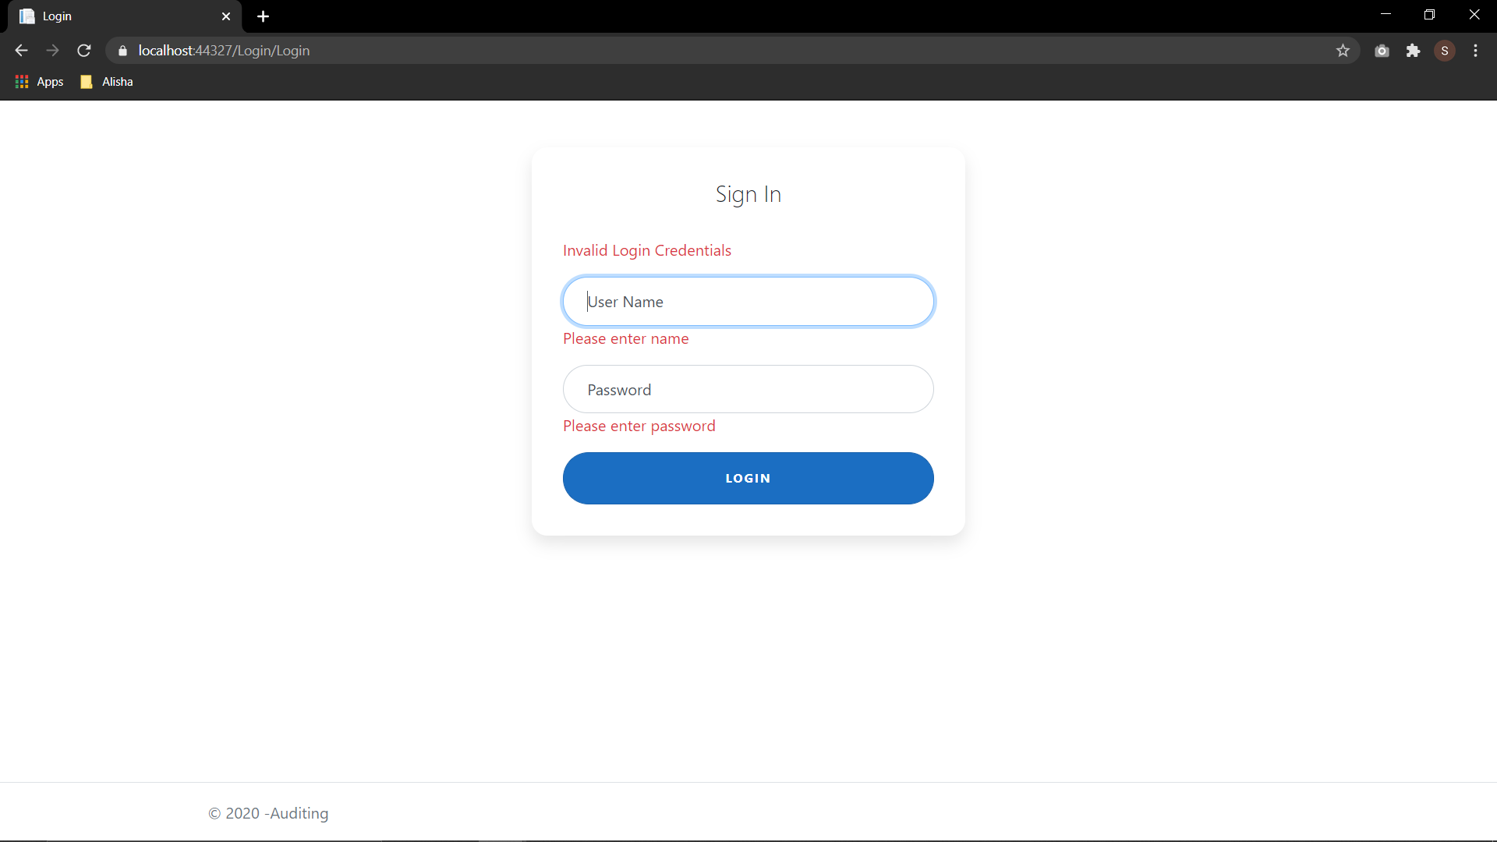
PROJECT FLOW

Slide 13
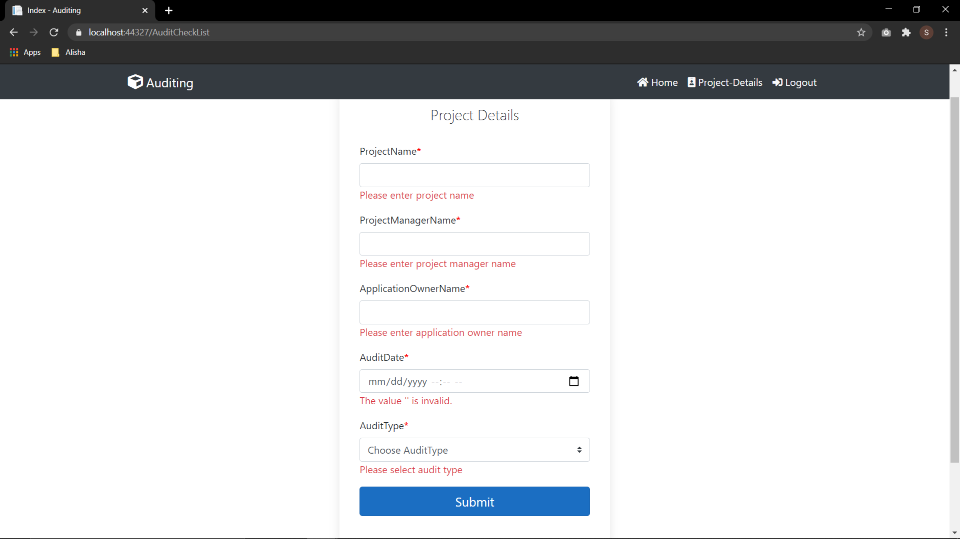
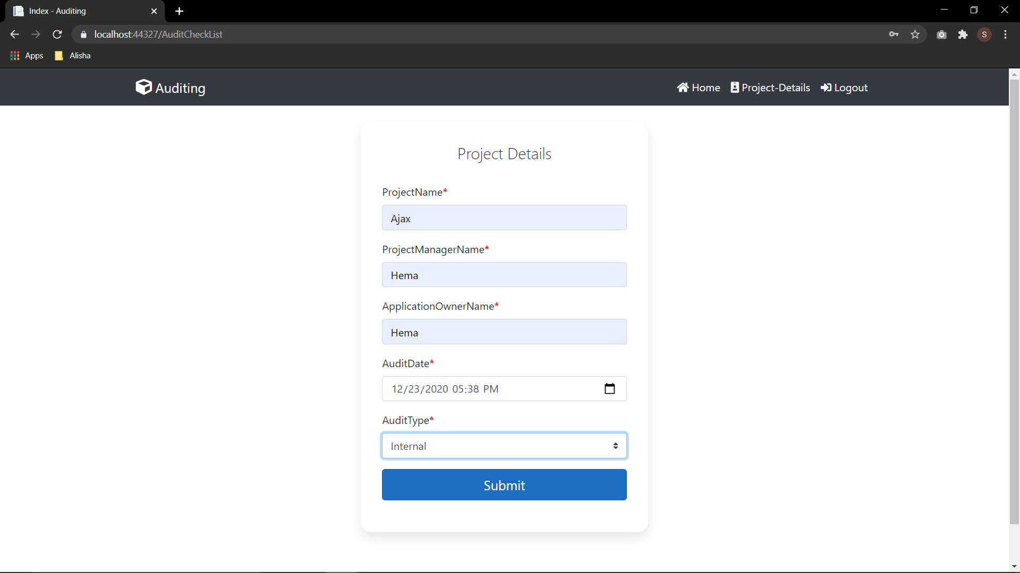
PROJECT FLOW

Slide 14
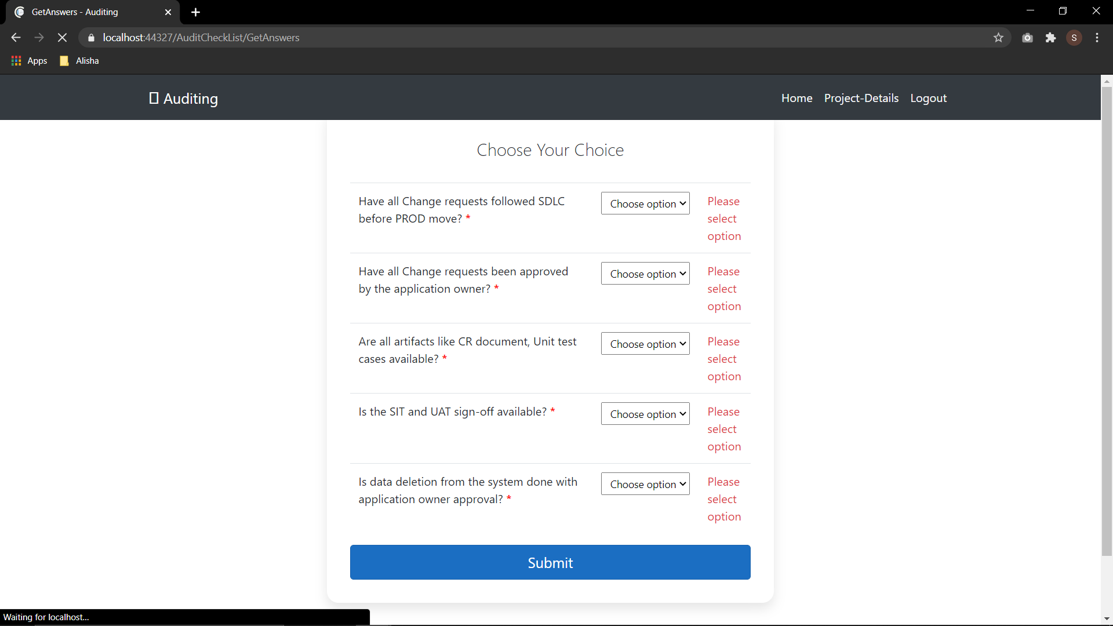
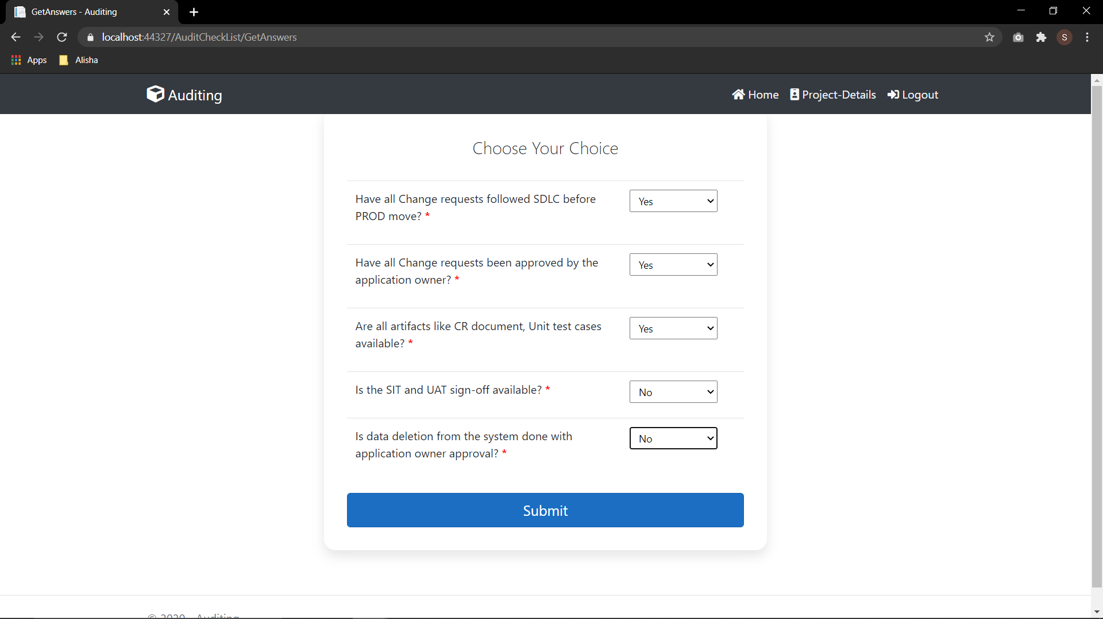
PROJECT FLOW

Slide 15
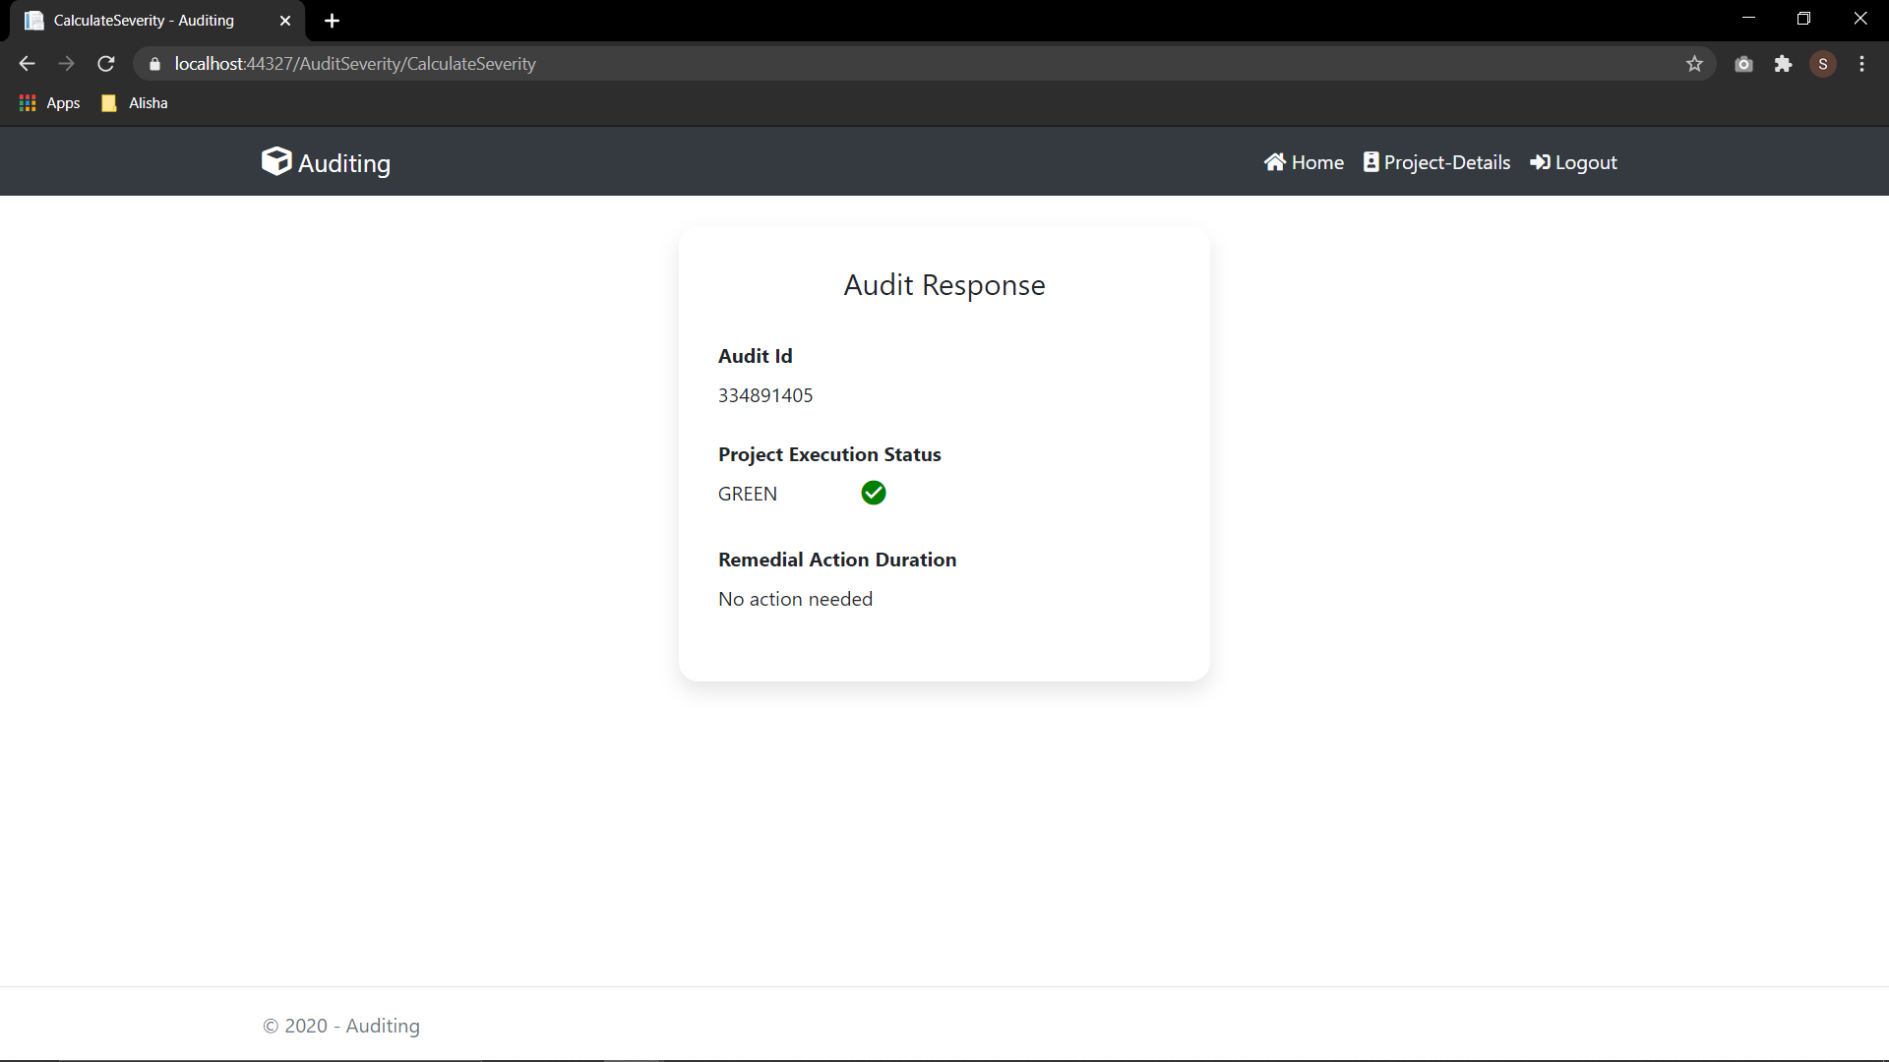
PROJECT FLOW

Slide 16
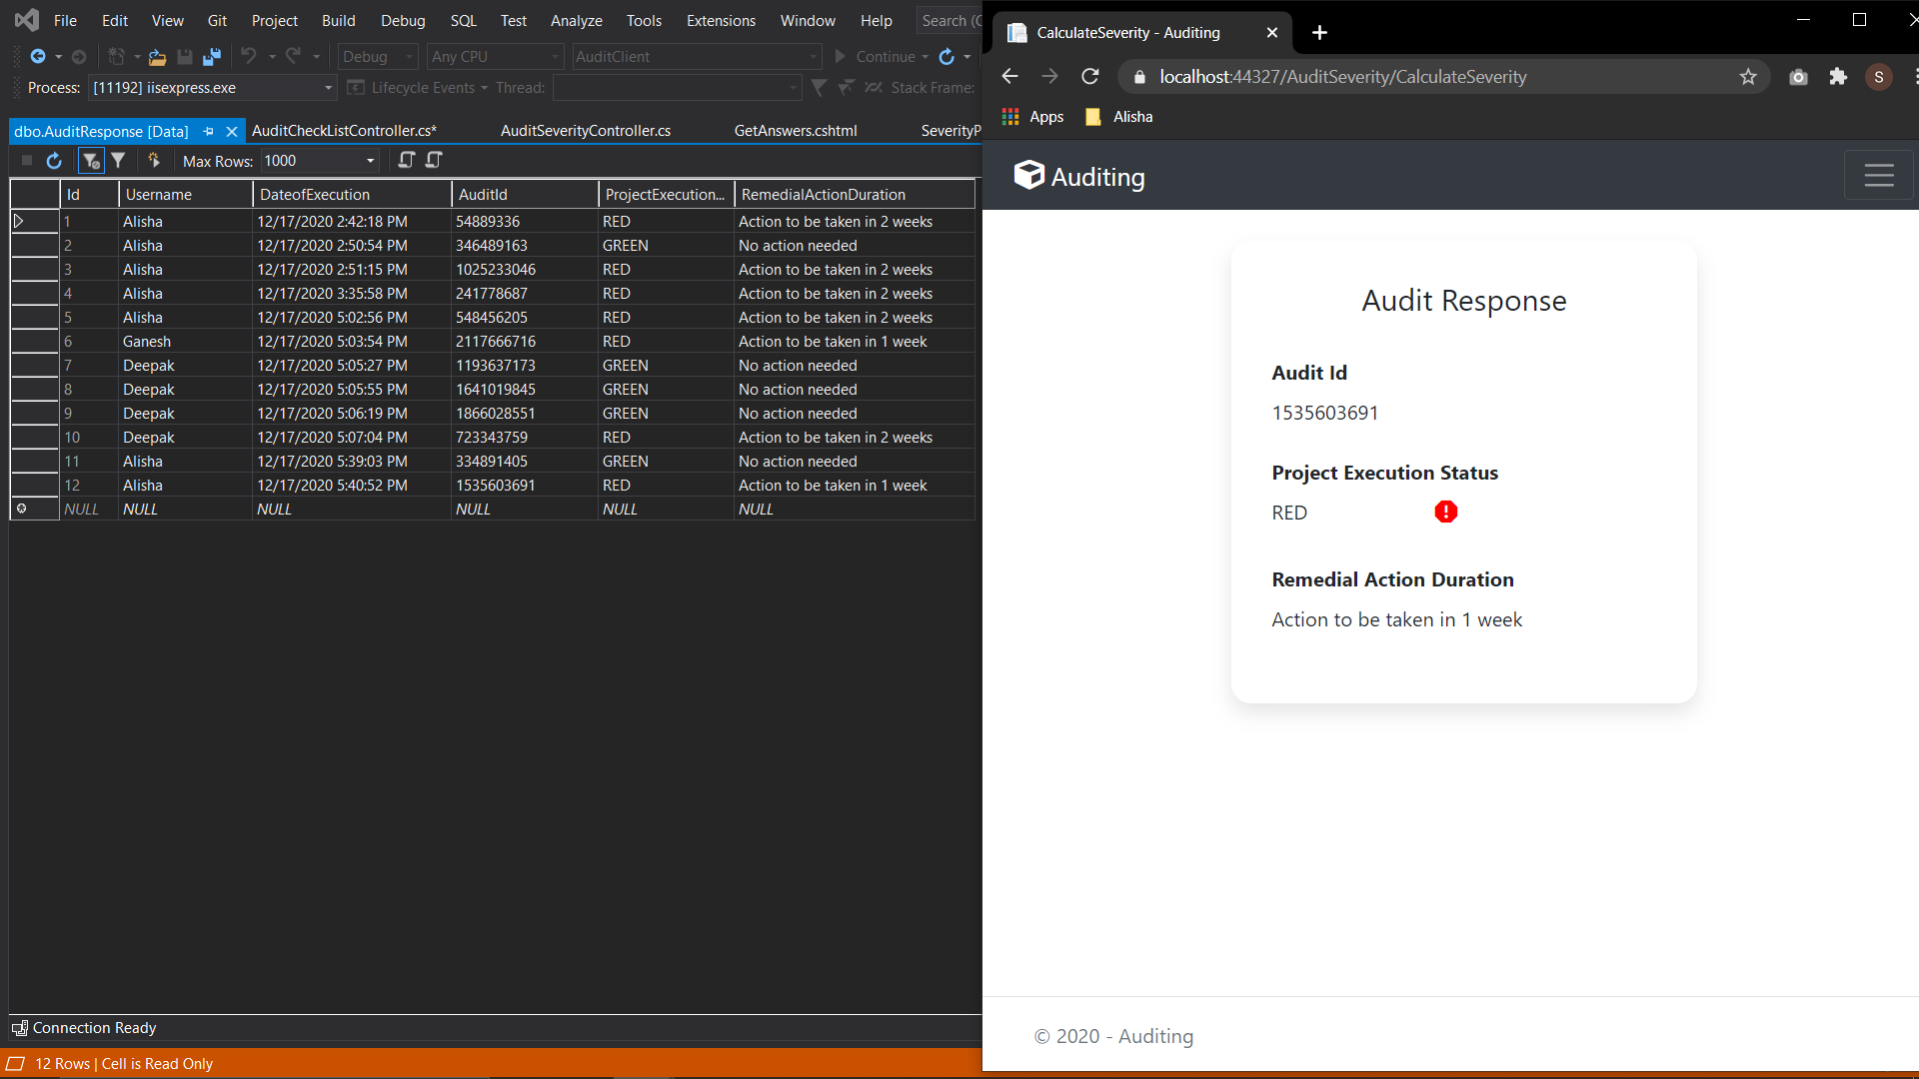
PROJECT FLOW

Slide 17
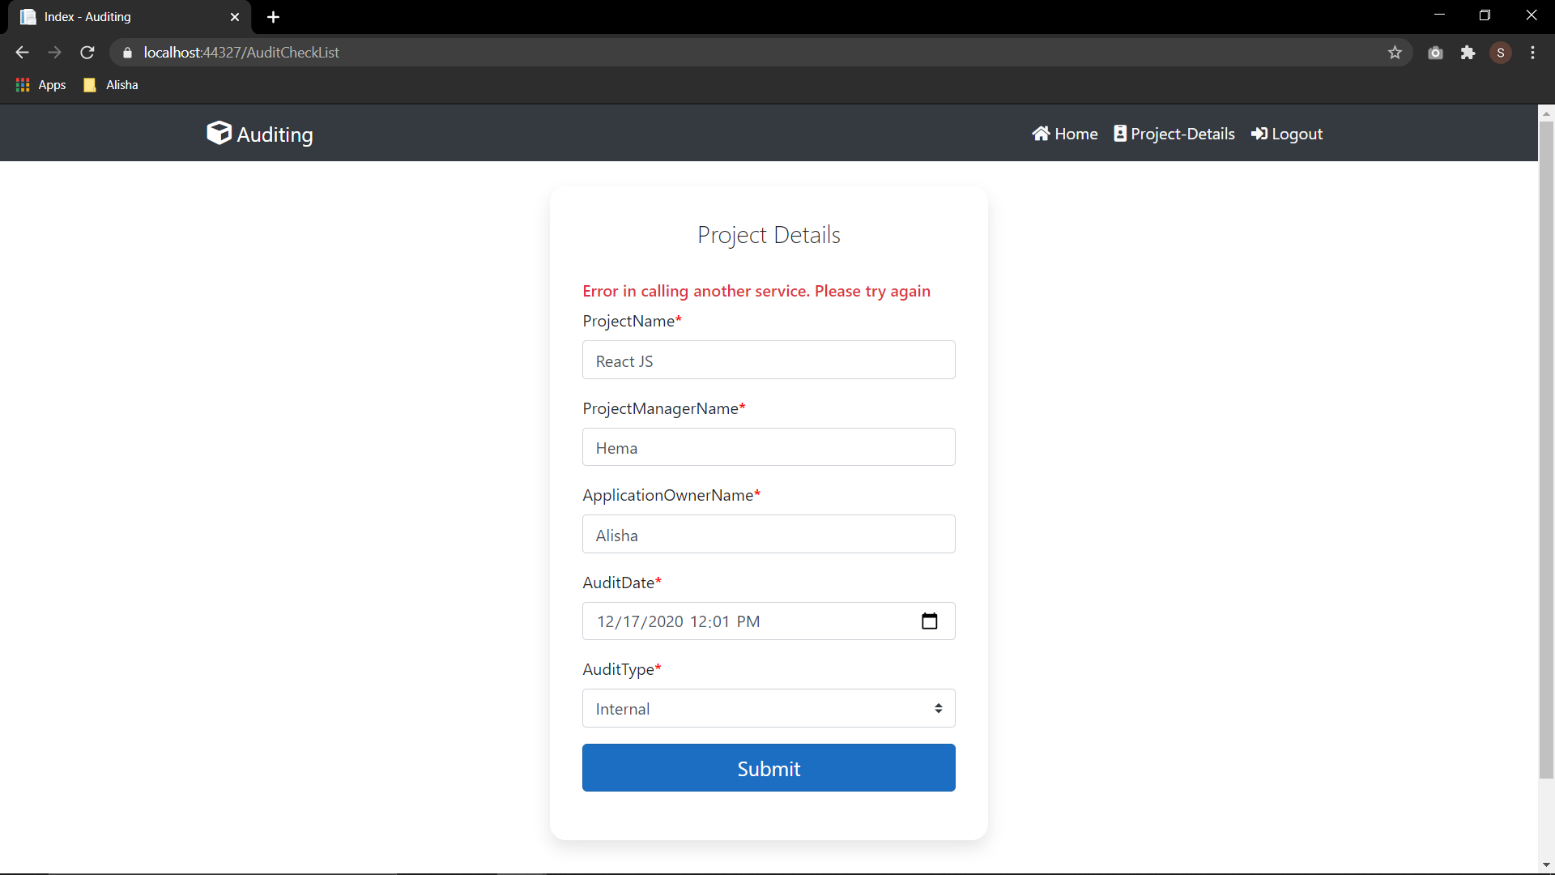
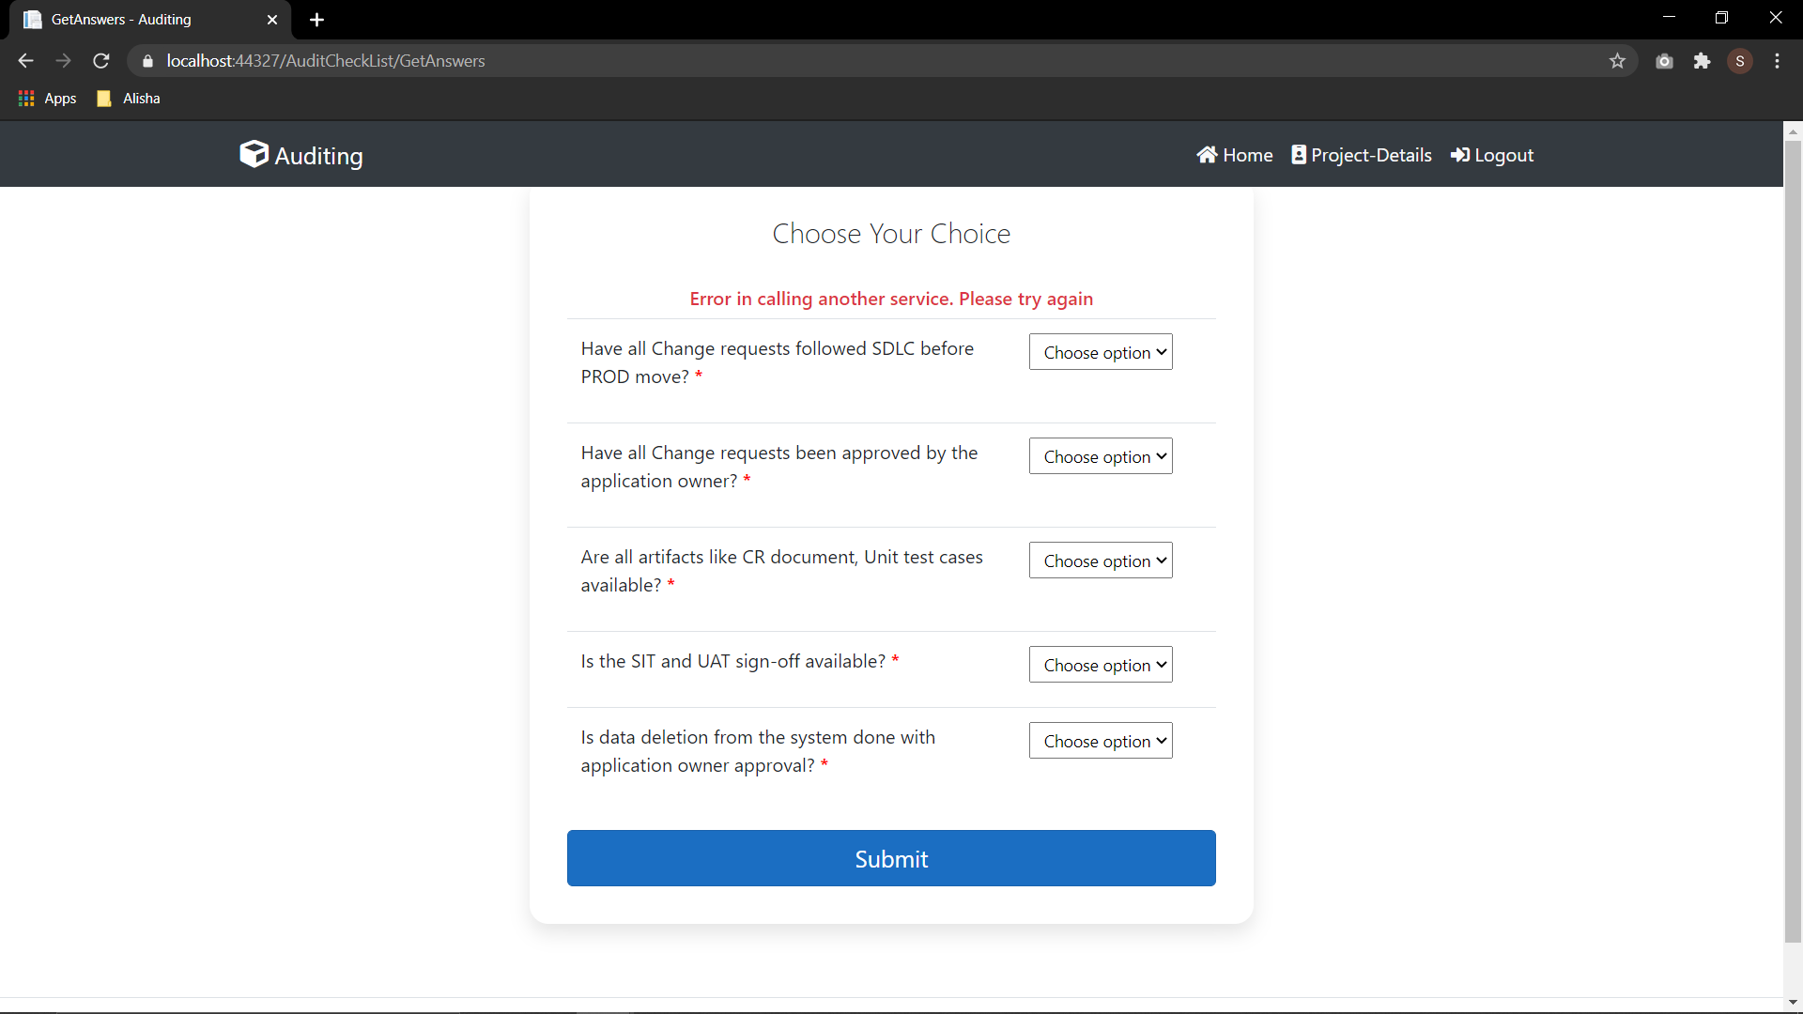
PROJECT FLOW

Slide 18
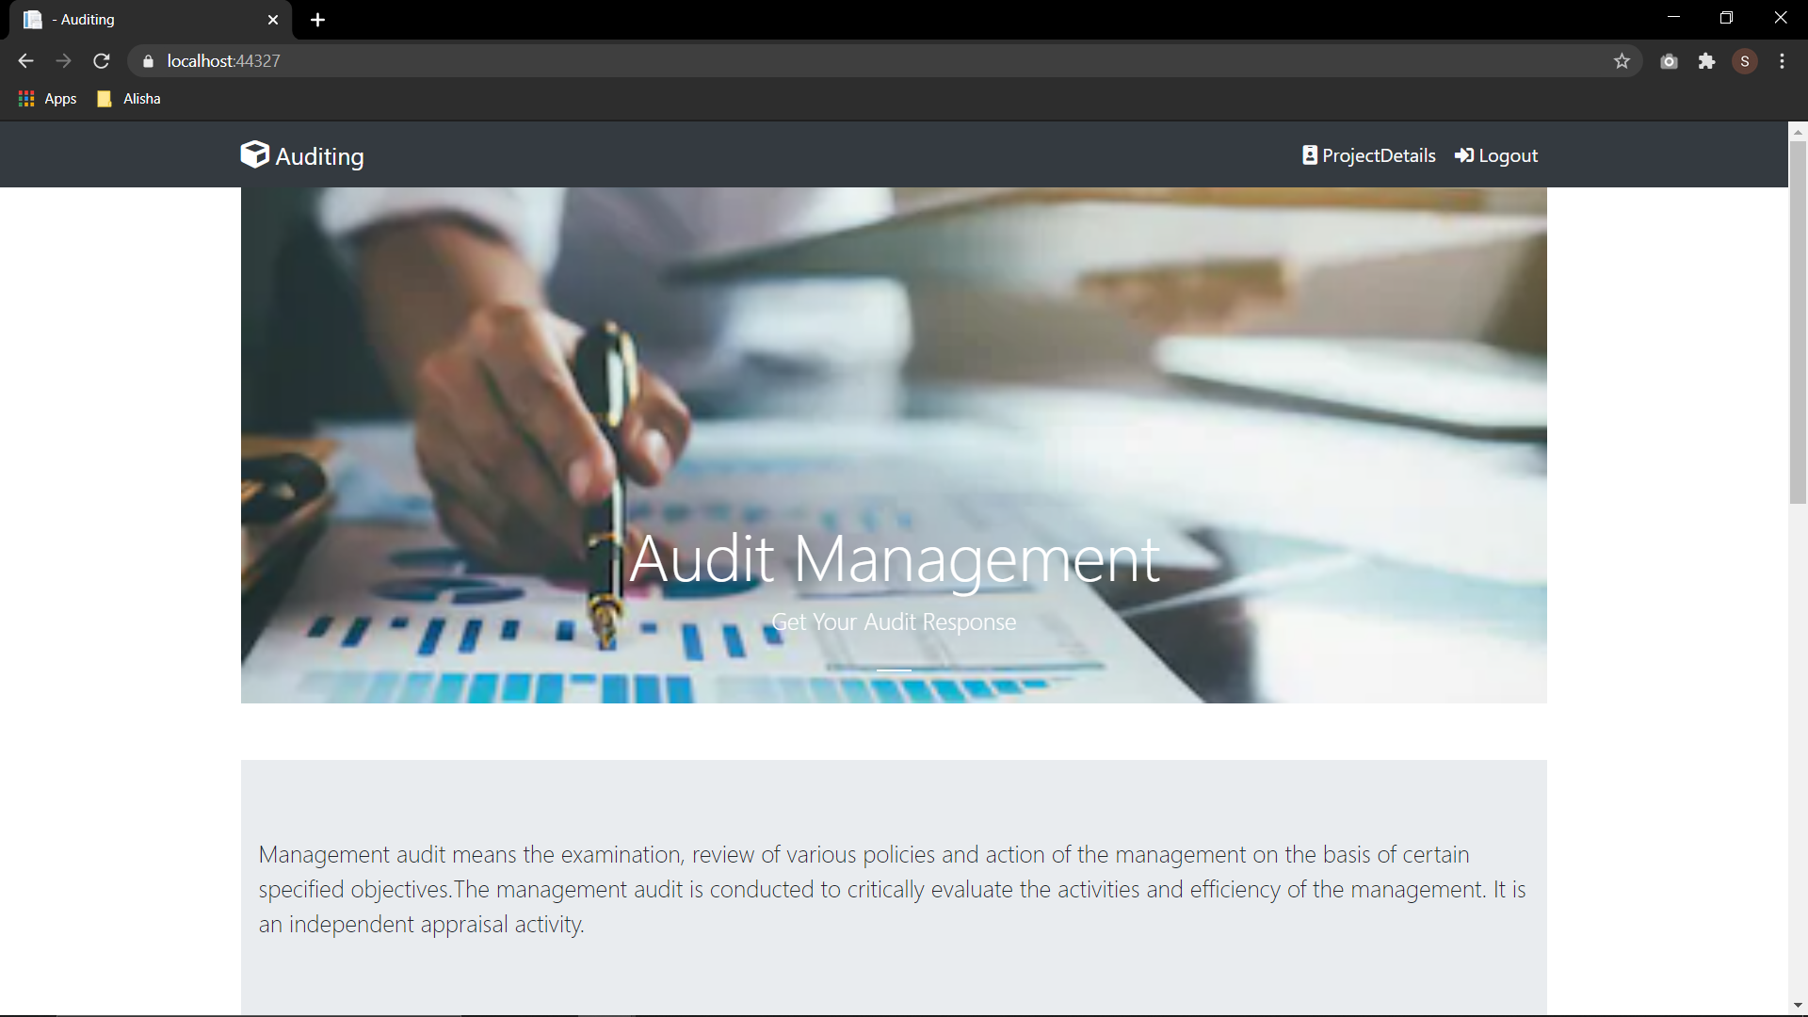
PROJECT FLOW

Slide 19
CONCLUSION
By doing this project we figured out how to examine use case document, how to divide work among us and helping each other to complete the tasks.
It likewise improved our insight into Microservices, C# concepts, EF core, coding guidelines and Naming Conventions, .NET center WebAPI, MVC Core and NUnit Testing and Logging.
We additionally learn deploy Microservices on cloud utilizing Microsoft Azure and how to edit the CI/CD pipeline

Slide 20
THANK YOU

